Slide 1
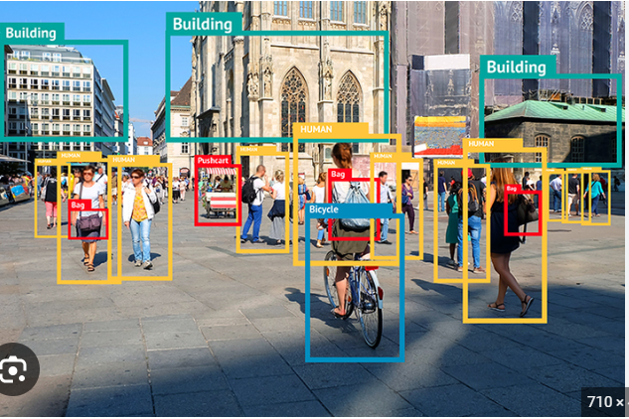

IMAGE PROCESSING
MENTOR:
MR. ASHWINI KUMAR
Made By:
SWAPNIL BISHT

Slide 2
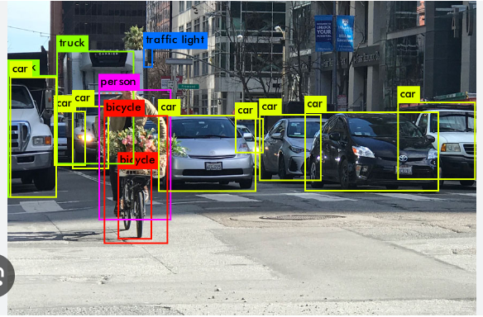
to
INTRODUCTION
IMAGE PROCESSING
Object detection is a fundamental task in computer vision that involves identifying and assigning multiple features of interest to a sequence of images or video This abstract presents the latest developments, challenges, and techniques in object recognition for detailed information on.
The abstract begins by highlighting the importance of object detection in various real-world applications such as autonomous vehicles, surveillance systems, medical imaging, and augmented reality Object detection the accuracy and efficiency of the process directly influences the performance of this project, making it a dynamic area of ​​research and development
The main method for object detection by Deep Learning such as Single Shot Multi box Detector (SSD), You Only Look Once (YOLO), and Faster R-CNN These deep learning methods have revolutionized object recognition by achieving state-of-the-art results with reduced audit time.

Slide 3

IMPORTANCE
Touchless Process [Safer]
Rapid Measurement [Visual Display]
Warning Alert
Eliminates Human Error
Cost effective
Public Awareness and Education
Real-time Monitoring
Image Representation
Filtering
Object Detection
Image Compression
Image Regeration

Slide 4
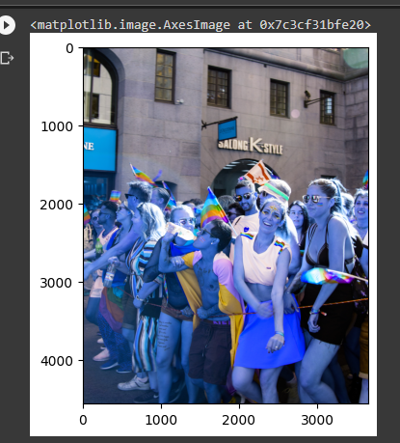
METHODOLOGY
•To start the project we are going to follow the Steps given below:
1.Import Libraries:- Import necessary libraries such as OpenCV, TensorFlow, NumPy, PIL, and Tkinter for GUI.
2.Argument Parsing:- Parse command-line arguments using the ‘argparse’ module to customize the behavior of the application. The arguments allow users to set thresholds conversions factors, input/output video paths, and other parameters.
3.Temperature Conversion:- Define a method ‘convert_to_temperature’ to convert the average pixel value (mean) obtained from the thermal image to temperature using conversion factor.
4.Process Thermal Frame:- Implement ‘process_temperature_frame’ to process the thermal frame from the video stream. The frame undergoes to color conversion , binary thersholding , erosion, dilation, contour detection,and temperatue extraction for each detected region.
5.Face Detection and Temperature Analysis:- Implement ‘process_temperature_face_frame’ to detect faces using a pre-trained deep learning face detection model and extract the temperature for each detected face using ‘process_temperature_frame’.
6.Face Mask Detection: Implement ‘detect_and_predict_mask’ to detect faces, predict mask/no-mask for each face using a pre-trained face mask detection model, and process the temperature for each detected face.

Slide 5
7.Tkinter GUI: Create a Tkinter GUI application to display the video stream with detected faces, mask/no-mask predictions, and temperature information. Users can set the temperature threshold and choose between Fahrenheit and Celsius units.
8.Video Loop: Continuously read frames from the video stream, apply face detection and mask detection, and update the GUI with bounding boxes, labels, and temperature information.
9.Button Click Handling: Handle the event when the user clicks the "Submit" button to set the temperature threshold based on the input provided in the text box.
10.Temperature Unit Conversion: Implement ‘sel’ to convert the temperature unit (Fahrenheit to Celsius or vice versa) based on the selected radio button.
11.Closing the Application: Handle the event when the user closes the application, ensuring that the video stream is stopped, GUI is closed, and resources are released properly.

Slide 6
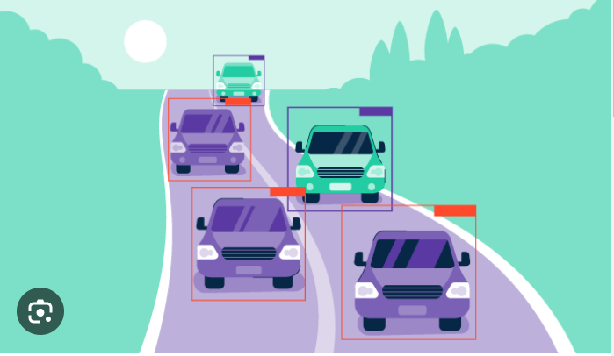
RESULT AND DISCUSSION
Object detection models require a diverse and well-annotated dataset for training. Commonly used datasets include COCO (Common Objects in Context), Pascal VOC (Visual Object Classes), and Image Net. Data preprocessing involves resizing images, data augmentation (e.g., rotation, flipping), and bounding box annotation.
During training, the model learns to optimize the loss function, which combines object detection accuracy and localization precision. Common loss functions include Smooth L1 loss and Cross-Entropy loss for classification. The models are evaluated using metrics like Intersection over Union (IoU), Precision-Recall (PR) curves, and Mean Average Precision (mAP).

Slide 7
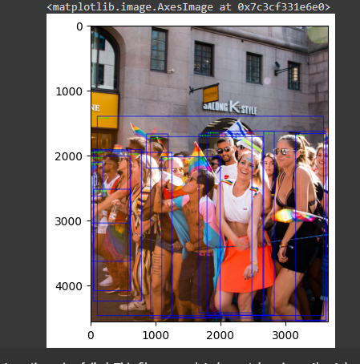

Slide 8
Conclusion and Future Work
In conclusion,The Face Mask Detection Project is an innovative and impactful endeavour that showcases the potential of computer vision and deep learning in promoting public health and safety. By combining real-time face mask detection and optional thermal screening, the system provides a robust solution to combat infectious diseases, contributing to a healthier and more secure future for society at large.
It is the combination for the face mask detector as well as the temperature detector.

Slide 9
Future Work:-
[1] Deep Learning Architectures: Deep learning models, especially Convolutional Neural Networks (CNNs), have been the driving force behind many changes in image processing and object recognition. In the future, more advanced designs and methods may emerge, providing greater accuracy and efficiency.
[2] Real-time and Edge Detection: As technology advances, there will be a strong emphasis on real-time sensing and edge processing. This includes providing lightweight models to nearby devices such as phone, cameras, or IoT devices, enabling fast and responsive applications without relying on cloud operations.
[3] Continual Learning: Continual learning aims to enable object detection models to continuously learn and adapt over time, which is crucial for applications where data distribution evolves over time.

Slide 10


